Slide 1
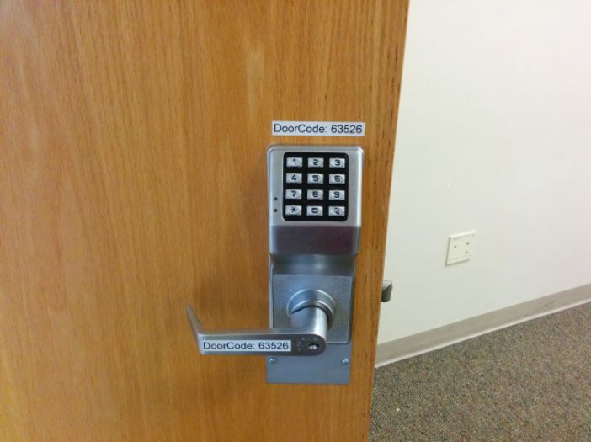
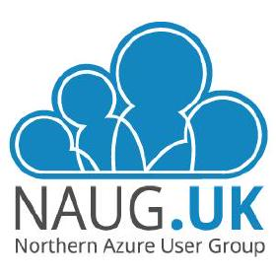

Azure Storage & Disk Encryption
Keep your keys safe!
Carl Syner
Sr Cloud Solution Architect
Tuesday 19th October 2021

Slide 2



Azure Storage and Disk Encryption Overview
Server-Side Encryption (SSE)
Platform Managed Keys (PMK)
Customer Managed Keys (CMK)
Double Encryption CMK + PMK
Azure Disk Encryption (ADE)
Windows (Bitlocker)
Linux (Dm-crypt)
Encryption Scopes
Host Encryption
Infrastructure Encryption

Slide 3
Azure Storage Key Facts
Since June 2017 Azure Storage automatically encrypts all data in a storage account at the service level (SSE) using 256-bit AES encryption , one of the strongest block ciphers available
Azure Storage is FIPS 140-2 compliant
Microsoft offer a plethora of encryption options to meet your customers needs – can be overwhelming
Beware of the limitations i.e. with Linux ADE after you've encrypted the OS volume, disabling encryption on the OS volume isn't supported. Once you enable Customer-Managed-Keys (CMK) for Azure Managed Disks, the feature can not be disabled.
NOTE: Encryption is an immense topic; e.g., SQL Always Encrypted, TDE, Host-based encryption for AKS clusters, TLS encryption used to protect data that is traveling between cloud services

Slide 4
Enterprise-Scale *security, governance, and compliance *One of the critical design areas
Define encryption and key management
Encryption is a vital step toward ensuring data privacy, compliance, and data residency in Microsoft Azure. It's also one of the most important security concerns of many enterprises.
Requirements for using customer-managed keys for native encryption mechanisms such as Azure Storage encryption:
Customer-managed keys.
Whole-disk encryption for virtual machines (VMs).
Data-in-transit encryption.
Data-at-rest encryption
Default to Microsoft-managed keys for principal encryption functionality and use customer-managed keys when required

Slide 5
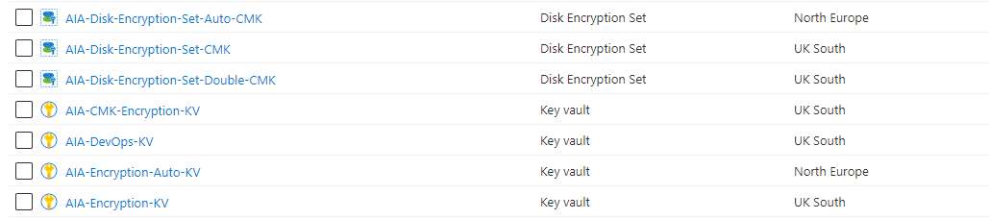
Server-side Encryption (SSE) Managed Disk
Server-side encryption of Azure managed disks - Azure Virtual Machines | Microsoft Docs
PMK – Default for all new Managed Disks
CMK – Gives customer more control of the encryption keys to meet compliance needs (GA April 2020) SSE improves on ADE by enabling customer to use any OS types and images, including custom images.
To use CMK you must first create a Disk Encryption Set and grant access to your Key Vault
Note:
Disk Encryption Sets DO NOT support RG or Subscription move

Slide 6
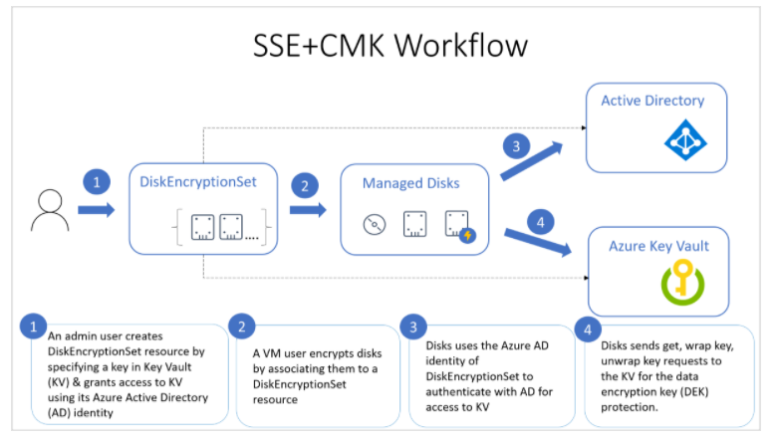
Managed Disk - SSE with CMK Workflow
Key Vault
Use Access polices or RBAC
Must grant get, wrap and unwrap when configuring your access policy

Slide 7
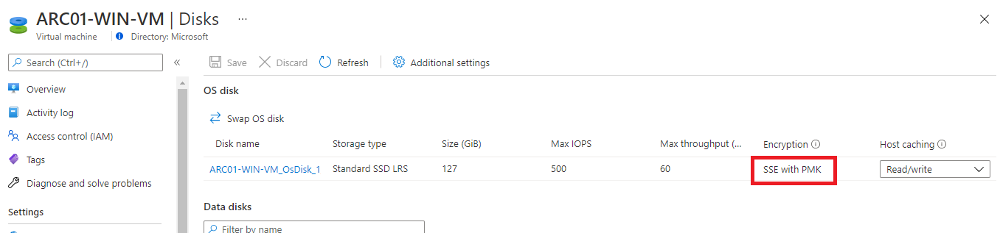
Managed Disk - SSE with PMK (Default)

Slide 8
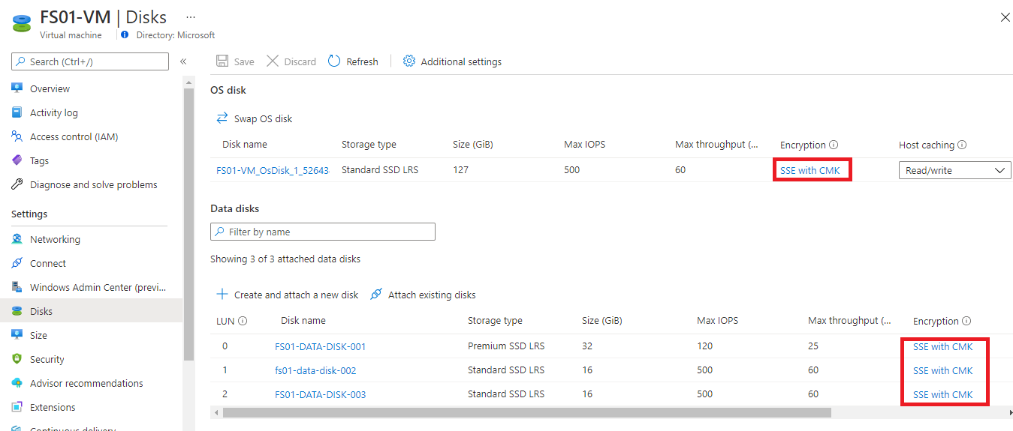
Managed Disk - SSE with CMK

Slide 9
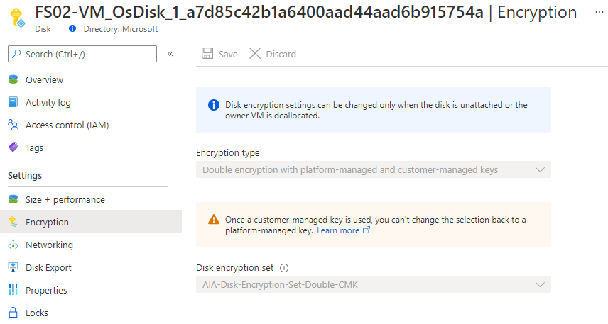
Managed Disk - SSE with CMK & PMK (Double)
Use case for Double Encryption ?
Configuration errors in data encryption
Implementation errors in the encryption algorithm
Compromised of a single encryption key

Slide 10
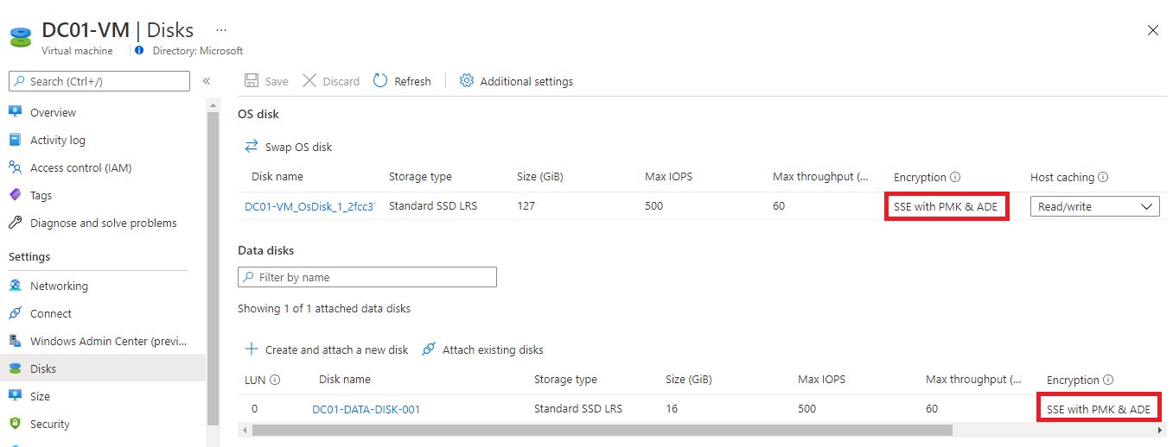
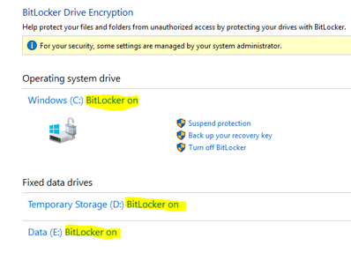
Managed Disk – SSE with PMK & ADE

Slide 11
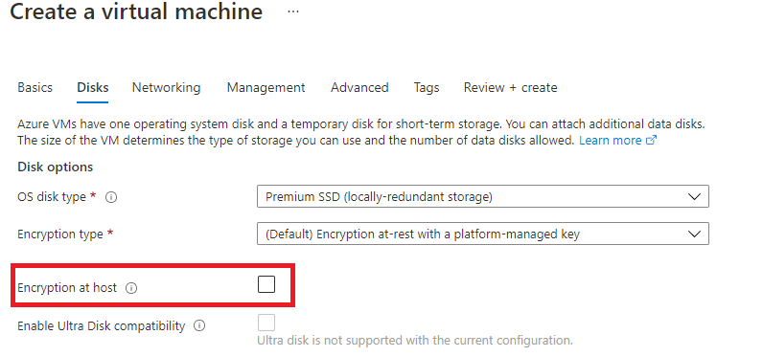
Encryption at Host
Encryption starts on the VM host itself, the Azure server that your VM is allocated to. The data for your temporary disk and OS/data disk caches are stored on that VM host. After enabling encryption at host, all this data is encrypted at rest and flows encrypted to the Storage service. Essentially, encryption at host encrypts your data from end-to-end.
Register EncrptionAtHost feature via Register-AZProviderFeature
ADE and Encryption at Host can not be used together
https://aka.ms/diskencryptionupdates
My opinion: Encryption at Host + SSE will be
the defector encryption solution implemented by
organisations, as opposed to SSE + ADE.
Note:
ADE cannot be enabled on disks that have
Encryption on host enabled

Slide 12
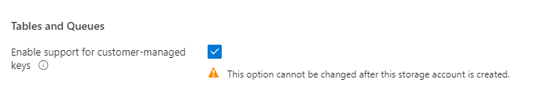
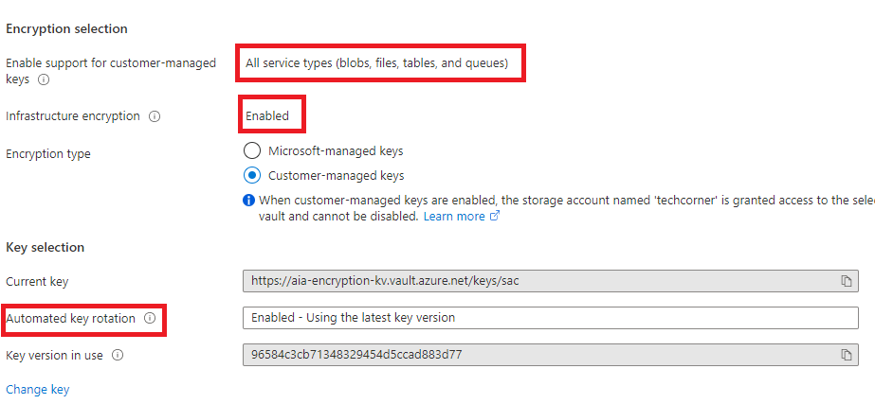
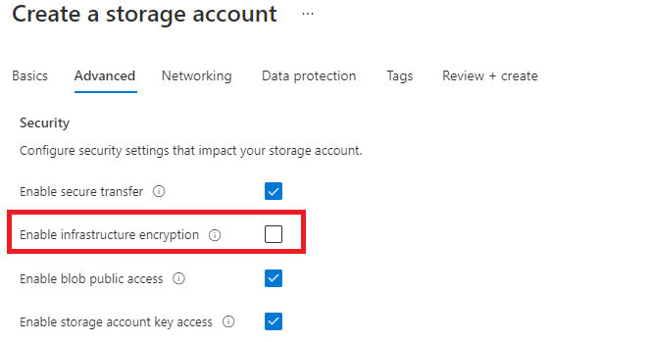
Storage Accounts – Encryption
When infrastructure encryption is enabled for a storage account or an encryption scope, data is encrypted twice — once at the service level and once at the infrastructure level — with two different encryption algorithms and two different keys

Slide 13
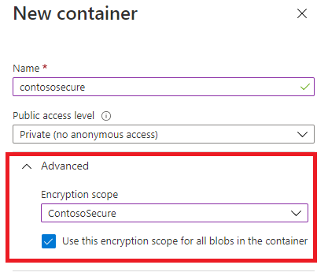
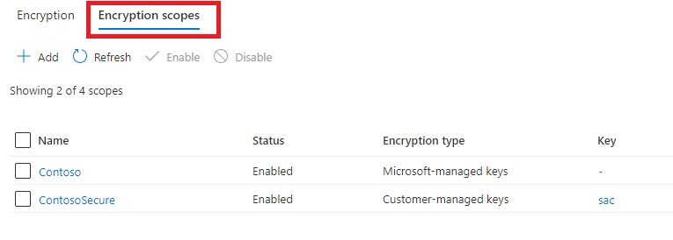
Storage Account Encryption Scopes
Manage encryption at the level of an individual blob or container.
Secure boundaries between data that resides in the same storage account i.e., data that belongs to different customers

Slide 14
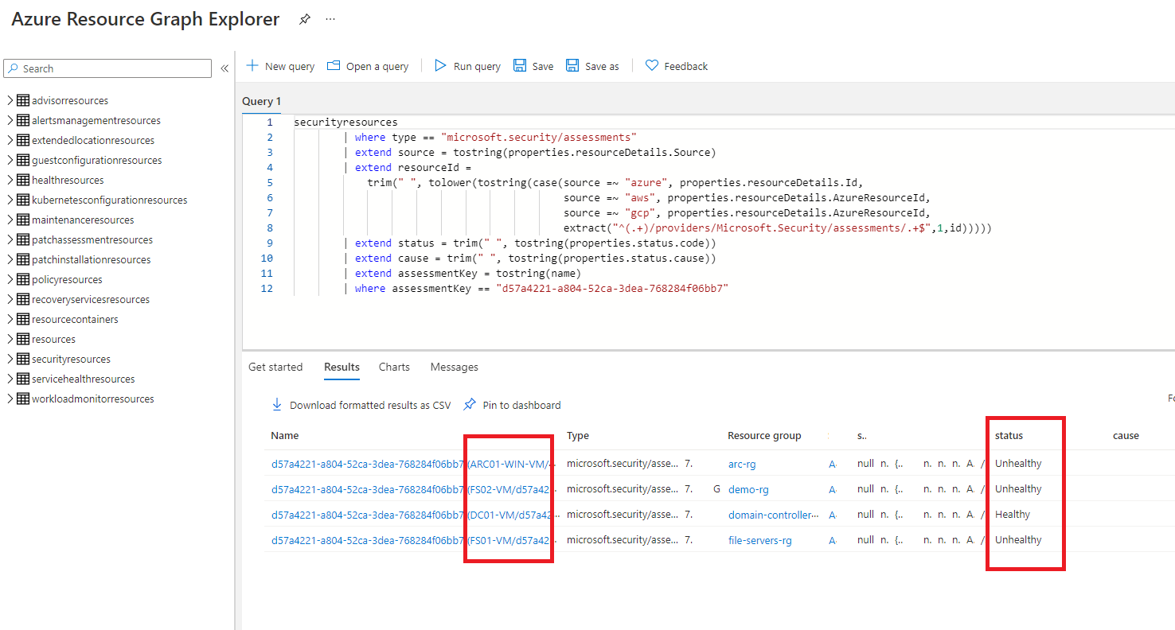
Azure Resource Graph Explorer – Kusto Query (KQL)

Slide 15
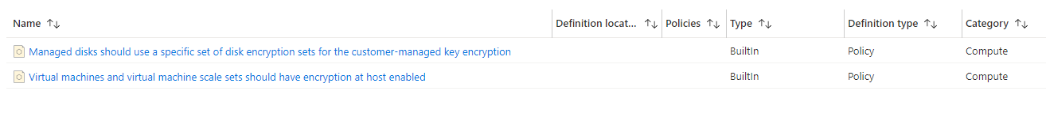
ASC – Default Polices

Slide 16
Appendix

Slide 17
Hardware Security Modules (HSM) offerings
 | Azure Managed HSM | Azure Dedicated HSM | Azure Key Vault | On-Prem HSM
Compliance | FIPS 140-2 Level 3 | FIPS 140-2 Level 3 | FIPS 140-2 Level 2 | ?
Cost | ££ Standard B1 | £££ Thales Luna 7 HSM A790 | £ | ££££
Management | Microsoft | Customer | Microsoft | Customer
Dedicated Capacity | Yes | Yes | No | Yes
Use Cases | Encryption-At Rest, Keyless SSL | Lift-and-Shift, Full Control, Keyless SSL, ADCS | Encryption-at-Rest | ?
M365 Integration | Yes | No | Yes | No
Automated Resilience | Multiple HSM Partitions that span AZ’s | Single Instance | Paired Regional | Single Instance

